Slide 1
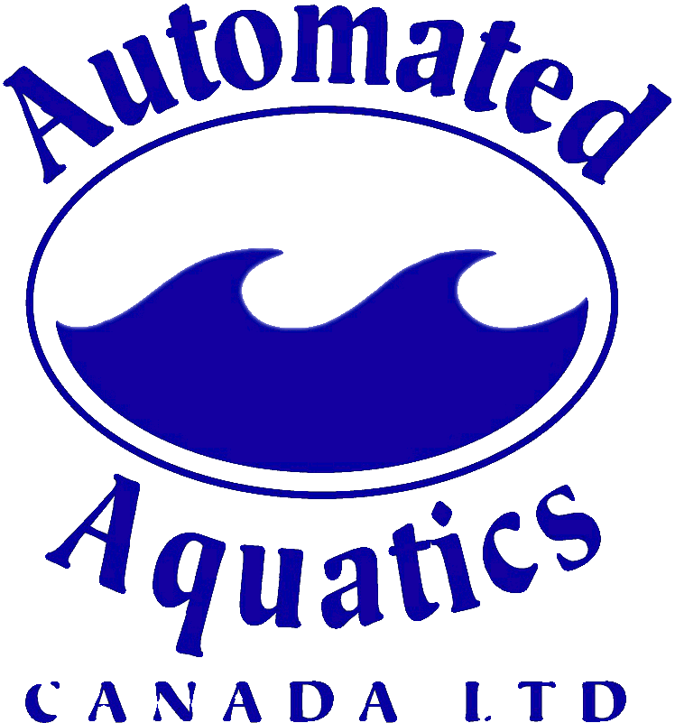
Optimizing air and water quality in Aquatic facilities
Including trichloramines, air testing, system efficiencies and filter & surge tank cleaning

Slide 2
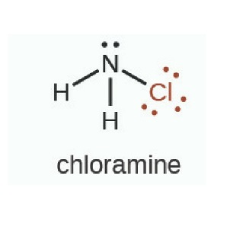
Some key terminology
Chloramines chloramines are the end result of undesirable oxidation reactions between free chlorine (HOCL) and nitrogen based ‘chloramine precursors’ such as urea (from sweat, urine, natural moisturizing factor in skin), creatinine, uric acid & personal care products. Chloramines exist in 3 main forms: monochoramine, dichloramine, trichloramine (aka nitrogen trichloride)
Trichloramine (ncl3) is a specific species of inorganic combined chlorine. It is largely responsible for the typical chlorine smell in pools. The odor nuisance and discomfort seem to be the least of the problems. The medical aspects of trichloramine are far more serious, ncl3 is a known irritant of the breathing system as well as of eyes, skin and mucous membranes. Clinical studies have documented the promotion of chronic diseases (e.g. Asthma) among swimmers, especially in poorly treated and poorly ventilated indoor swimming pools and spas. Trichloramine is considered to be a causative agent for respiratory ailments.

Slide 3
Factors affecting air and water quality
Contamination
Filtration Systems
Hydraulics
Chemical Levels
Supplementary Systems
Dilution
Testing and Monitoring Methods

Slide 4
contamination
Contamination by bathers is why pools require filtration systems and chemical treatments
Many types of contamination cause air and water quality issues in the form of chloramines
Chloramines are the end result of undesirable oxidation reactions between free chlorine (HOCL) and nitrogen based ‘chloramine precursors’ such as urea (from sweat, urine, natural moisturizing factor in skin), creatinine, uric acid & personal care products. Chloramines exist in 3 forms:
Monochoramine (found in domestic water as a disinfectant)
Dichloramine
Trichloramine (aka nitrogen trichloride)

Slide 5
contamination
Bathers are the key source of contamination in swimming pools
The contamination by bathers can build up in various parts of the mechanical system
Surge tanks, vacuum filter tanks, sand filters and pressure D.E. Filter tanks all hold contamination from bather waste
The bather waste builds up in oily films. When bacteria colonies start to grow in the films, they’re called biofilms

Slide 6
contamination
We have tested water from the sand filter tanks of 9 City of Edmonton facilities and all of them test positive for Pseudomonas and had HPC counts over 58,000 cfu/ml (prior to cleaning)
After chemical cleaning, the filter tanks no longer tested positive for pseudomonas
One facility was evacuated due to extremely high chloramine off-gassing from a surge tank, causing respiratory distress for staff
After cleaning the trichloramine off-gas from the surge tank was greatly reduced. A biofilm buildup was noted by the team cleaning the tank

Slide 7
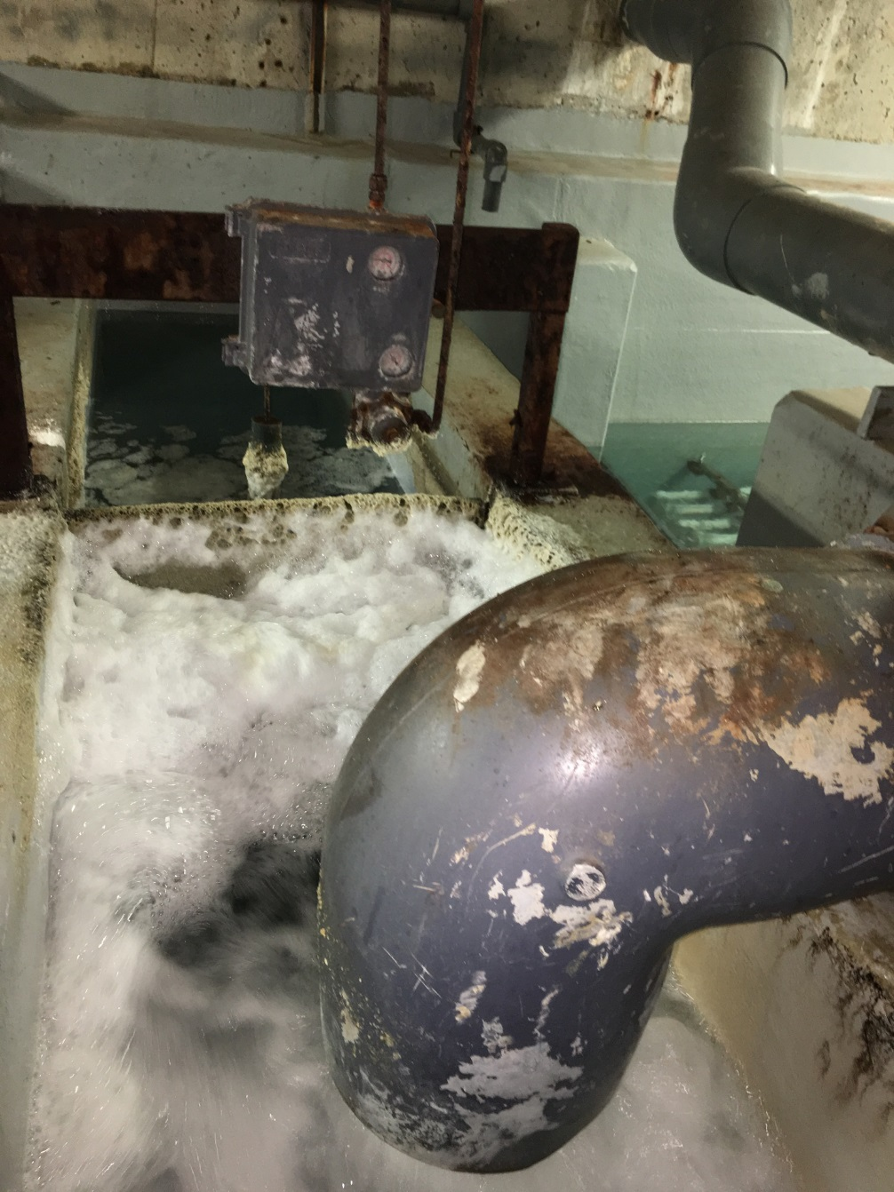
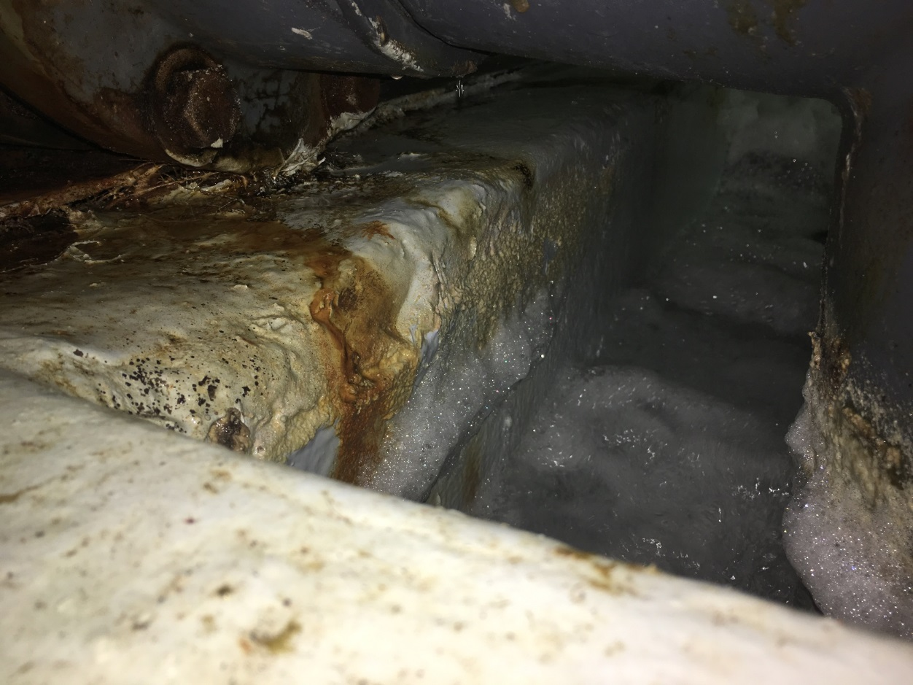
Heavily contaminated OPEN Filter tank!

Slide 8
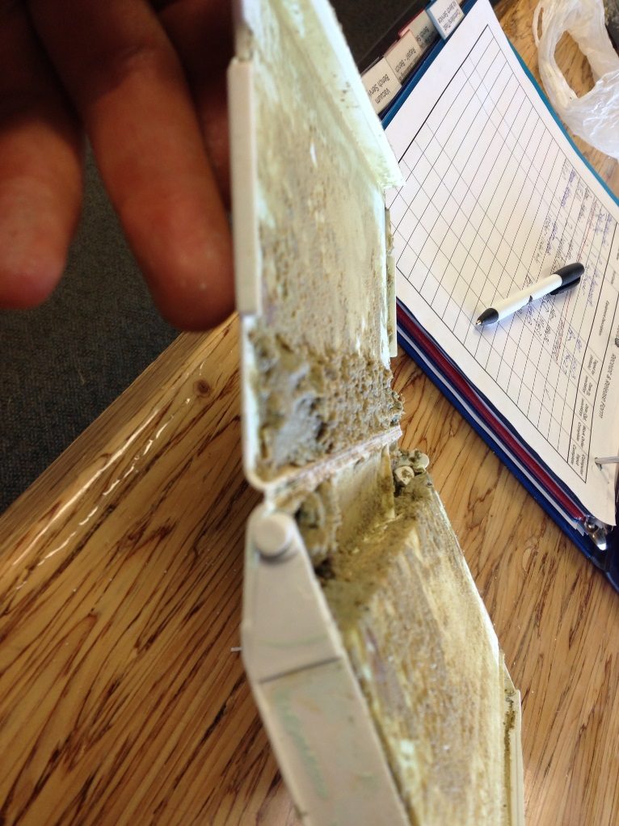
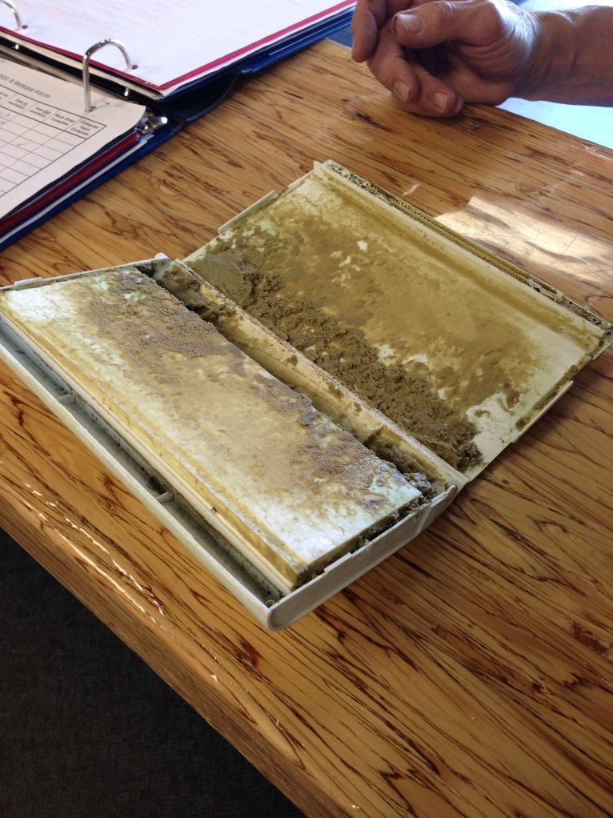
Biofilm growth in skimmer weirs

Slide 9
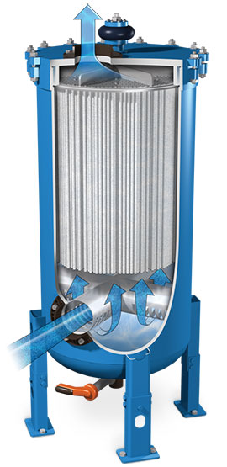
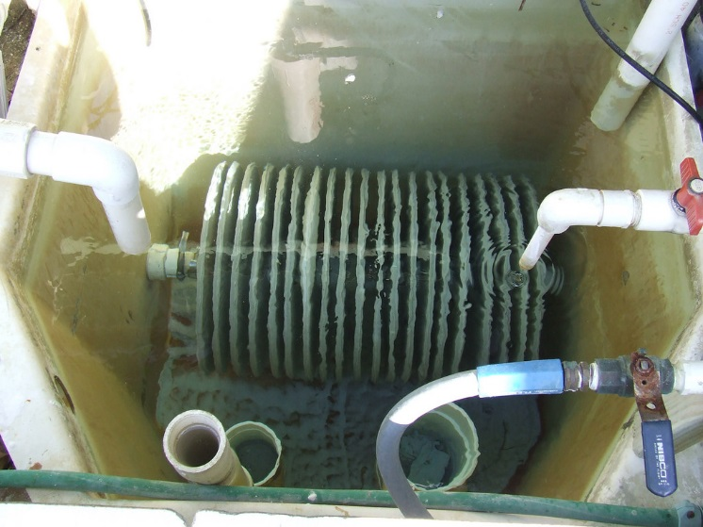
Filtration systems
Vacuum media (d.e/Perlite) Pressure Media (D.e./Perlite)

Slide 10
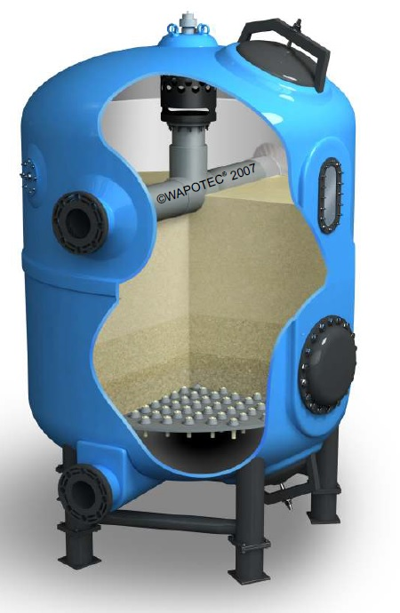
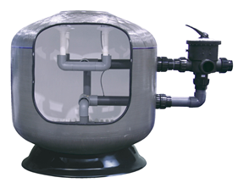
Filtration systems
multi-layer sand Sand

Slide 11
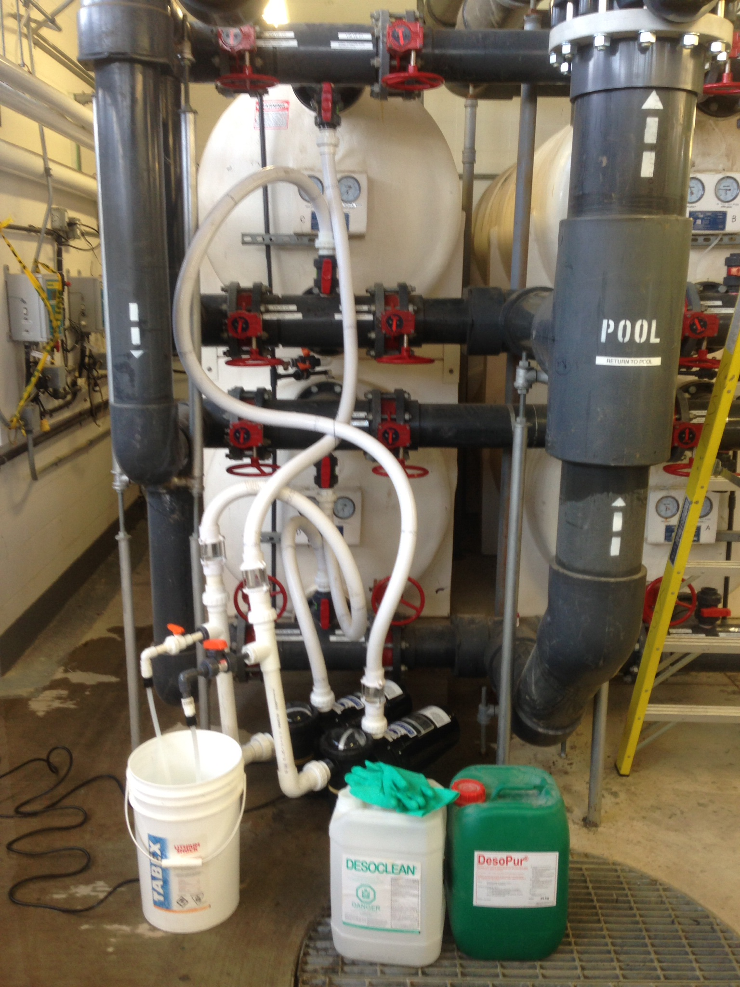
Optimizing filtration systems
Regular chemical cleaning of all types of filter tanks and media (every 6-12 months)
Clean surge and balance tanks every year (chemically)
Replacement of sand media every 3-7 years depending on type of filter and cleaning practices
Use of filtration enhancement chemicals (flocculants for sand, clarifiers for other filters)
Operating filtration systems at low filtration rates (regulation allowing)

Slide 12
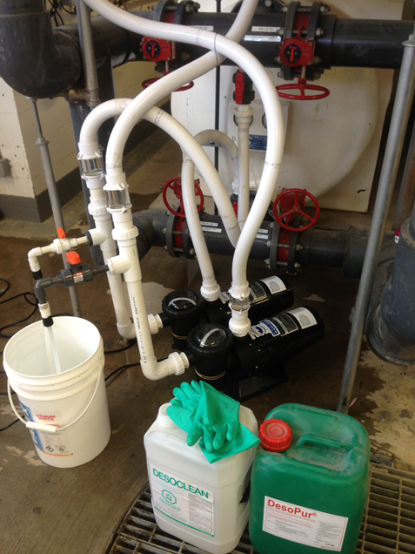

Slide 13
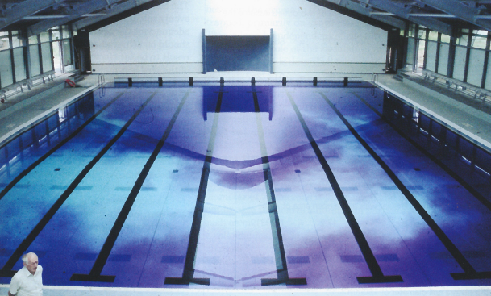
Pool Hydraulics
Pool hydraulics can have a heavy impact on air and water quality
Dead spots exist in most pools
Renovations and new builds should prioritize perimeter overflow skimming and floor inlets
Dye testing is an extremely useful tool to evaluate hydraulics

Slide 14
Optimizing Hydraulics
Dye test to evaluate hydraulics
Adjust skimmers to pull evenly
Adjust inlets to return evenly
Re-dye test every few years to evaluate changes and respond to them

Slide 15
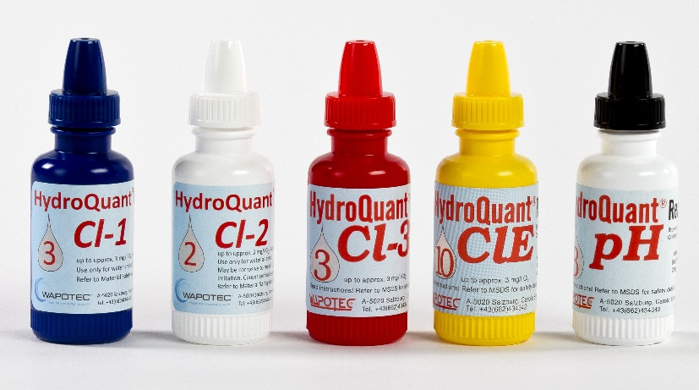
Chemical balance and levels
Looking at BC Pool Regulations:
“The pH level of pool water must be tested at least twice daily and maintained at no less than 7.2 and no more than 7.8”
Free chlorine must be maintained at a minimum of 0.5ppm for pools <30C and 1.5ppm for pools >30C
“The combined chlorine in pool water must be tested at least twice daily and maintained at a concentration of less than one part per million”
“The alkalinity of pool water must be tested at least weekly and maintained at a level no less than 80 parts per million and no more than 120 parts per million”

Slide 16
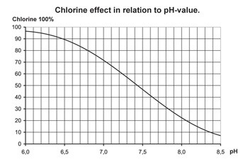
Optimizing chemical levels for fantastic water and air
Studies have shown formation of undesirable combined chlorine compounds doubles going from 0.4ppm to 1.5ppm free chlorine. This reduces air quality, and bather comfort.
Run your chlorine as low as regulation allows, if other systems are in place to maintain water quality
Chlorine is exponentially more effective at a lower ph. Keep your pH set point as low as regulation allows
Improve filtration and oxidation systems, and increase dilution to maintain low combined chlorines

Slide 17
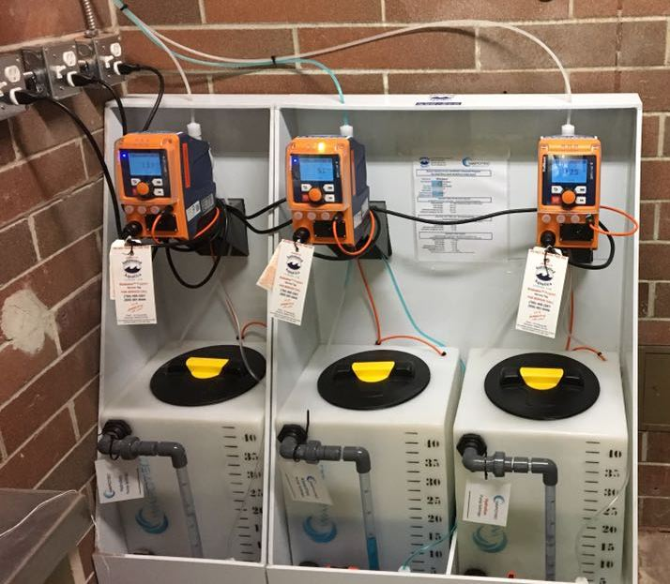
Supplementary systems
Types of systems:
Inline UV
Flocculants & filtration enhancement
Chlorine dioxide
Ozone

Slide 18
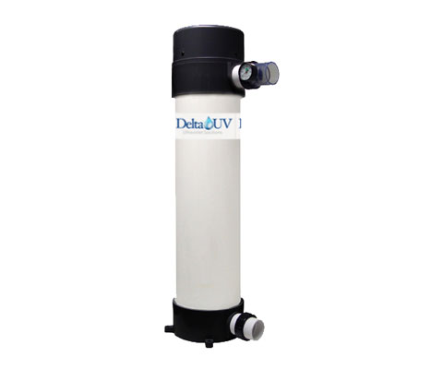
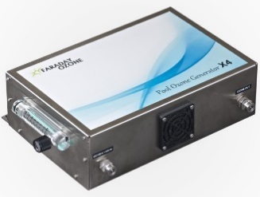
UV & Ozone
UV
Fantastic technology for domestic water systems (pre-chlorination)
Some European countries have found that UV increases the rate that chloramines are converted to trichloramine, which off-gasses from the water causing air quality issues
Ozone
Ozone systems are very effective if they are a full stream system (take all of the pool water). Hydraulics are a limiting factor
The capital expenditure of doing this is astronomical
Unlike European systems, ozone systems here don’t generally have a de-ozonation tank
Ozone gas is very dangerous and can be accidentally released from some ozone systems

Slide 19
Flocculants (filtration enhancement) & Chlorine dioxide
Chlorine Dioxide:
Chlorine dioxide effectively destroys biofilms, legionella and pseudomonas
Chlorine dioxide has a residual in the water (0.2-0.5ppm) providing constant protection
It can be generated in the presence of chlorine cost effectively and safely with a TCDO liquid
Flocculants
Are required on sand filter systems by German DIN Standards (in German aquatics facilities)
Greatly improve the efficiency of sand and multilayer filtration systems
Keep contamination on the filter surface so it can easily be backwashed out
Allow the filter to remove precursors to “combined chlorines”

Slide 21
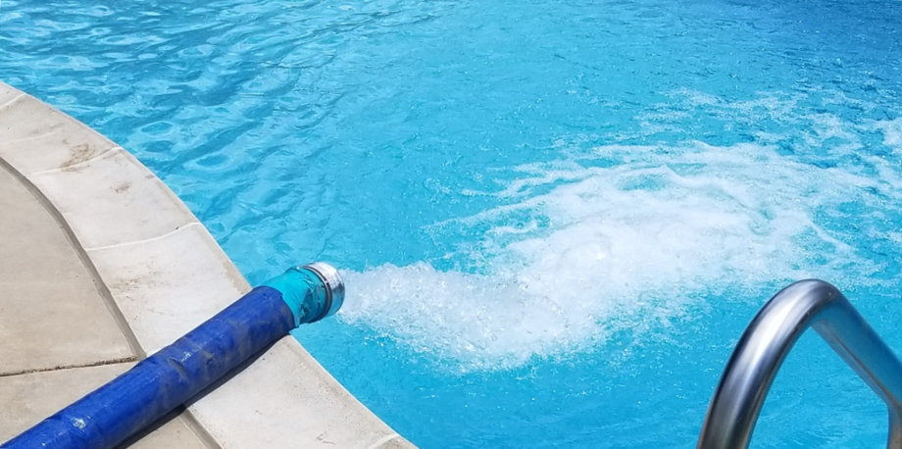
Dilution
How much fresh water do you add to your pool?

Slide 22
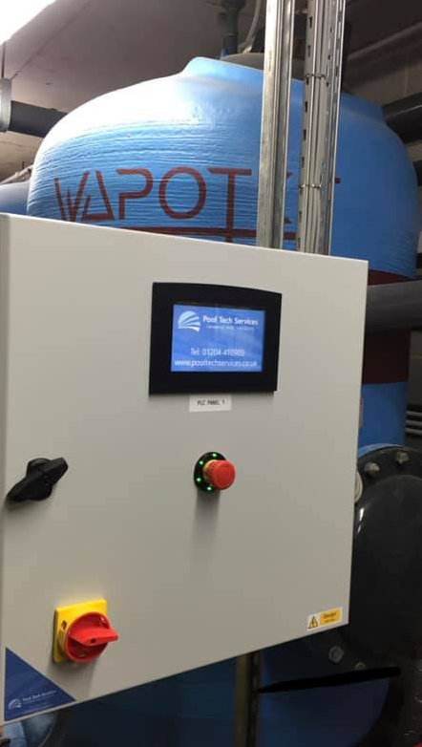
Some factors affecting dilution
Type of filtration system (sand/multi-layer filter system tend to have naturally better dilution because of backwashing)
Vacuum/pressure D.E./Perlite systems don’t use as much water for filter maintenance, so extra dilution is needed
Chemical levels in source water (pH, alkalinity, monochloramine)

Slide 23
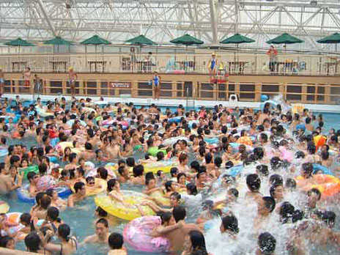
Optimum Dilution
The best practice is to add approximately 30L per bather, per day

Slide 24
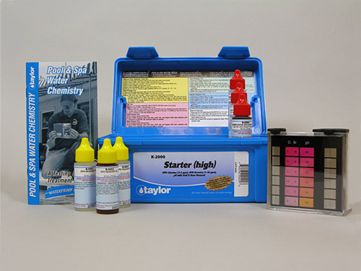
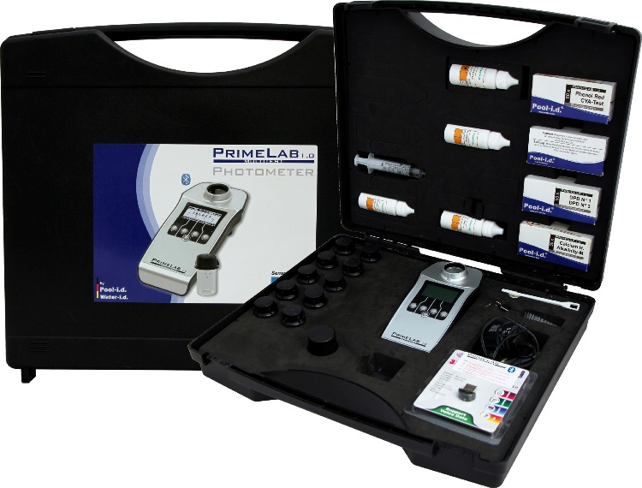
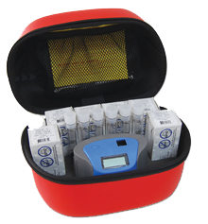
Water testing and monitoring

Slide 25
Some common misconceptions
Testing only the parameters required by the local health authority, is all the information you need to know for great water quality
Test kits using comparators are just as accurate as photometer type kits
All “combined chlorine” is the same
Good water tests mean good air quality

Slide 26
Clearing up the myths
Testing only the parameters required by the local health authority, is all the information you need to know for great water quality
A number of other parameters tell you a ton about water quality such as:
Turbidity
Oxidizer levels (chlorine dioxide or MPS)
Monochloramine
Phosphate

Slide 27
Clearing up the myths
Test kits using comparators are just as accurate as photometer type kits
Photometers remove the human error element from water testing
Some photometers use a single wavelength of light. These don’t test multiple parameters accurately
Higher quality photometers use multiple wavelengths of light to measure different colored reagents

Slide 28
Clearing up the myths
All combined chlorine is the same
Many municipalities use monochloramine as a disinfectant in tap water.
Conventional combined chlorine tests measure monochloramine, dichloramine, and all other oxidizers in the water.
Monochloramine itself shows up as combined chlorine with most test kits, but doesn’t cause major problems in pools until its converted to di and trichloramines. High pH levels, high chlorine levels, and certain technologies increase the rate that monochloramine transforms to di and trichloramines.

Slide 29
Clearing up the myths
Good water tests mean good air quality
Conventional combined chlorine tests don’t differentiate chloramine types
All pools will have some level of trichloramine in the air, no matter how great the system
Air handling systems can have a huge contributing role in air quality

Slide 30
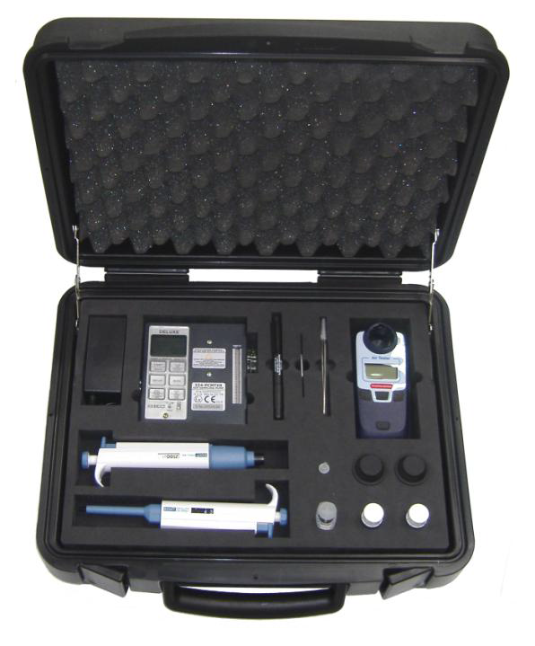
Trichloramine air testing
Onsite trichloramine testing services are available
We’ve done extensive trichloramine testing and found most pools have levels higher than recommended maximums
WorkSafeBC recommends a maximum trichloramine of 0.35 mg/cubic meters
The World Health Organization recommends a maximum of trichloramine of 0.50 mg/cubic meter
In our testing we’ve found levels from 0.25mg/cubic meter to 1.66mg/cubic meter. Average 0.45mg/cubic meter
The worst air is generally above open filter/surge tanks (1.66mg/cubic meter)

Slide 31
Optimizing testing and monitoring at your facility:
Upgrade your test equipment to a high quality photometer
Test more parameters than required by law
Start testing turbidity either with a portable meter or inline turbidity meters
Have your air tested for trichloramines
Use a test kit that can differentiate monochloramine/dichloramine
Monitor your air quality on an ongoing basis

Slide 32
Questions?

Slide 33
Thank you for attending!
Please stay in touch with us for any further information! John Duiker
Manager, Strategic Business Operations Automated Aquatics Canada Ltd.
JohnD@automatedaquatics.com
780-468-3261 (Office)
780-975-2631 (Cell)

Slide 34
References
Chloramines Safe Work Practices. Workers’ Compensation Board Of British Columbia. 2014
Guidelines For Safe Recreational Water Environments. Volume 2, Swimming Pools And Similar Environments. World Health Organization. 2006
Factors That Affect Air Quality In Indoor Pool Facilities. World Aquatic Health Conference Denver, CO October 18-20, 2017
Code Of Practice THE MANAGEMENT AND TREATMENT OF SWIMMING POOL WATER. Pool Water Treatment Advisory Group. 2014

